Slide 1
Huffman Coding
Module 22

Slide 2
Additional Videos
Huffman Code
  https://www.youtube.com/watch?v=iiGZ947Tcck
  ** | https://www.youtube.com/watch?v=IuFKDrdmgIQ
  https://www.youtube.com/watch?v=OtDxDvCpPL4
  https://www.youtube.com/watch?v=JsTptu56GM8
Harvard | Advanced Algorithms
  https://www.youtube.com/watch?v=edOWKZE1t84&list=PL2SOU6wwxB0uP4rJgf5ayhHWgw7akUWSf&index=4

Slide 3
Huffman Coding
“This is an example of a Huffman tree”
Compression algorithm
What’s the file size, if the info is saved in a file?
Can we do better?
Notes:
Hello.txt

Slide 4
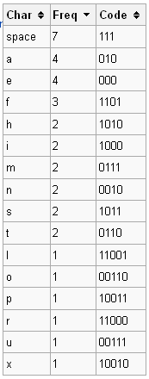
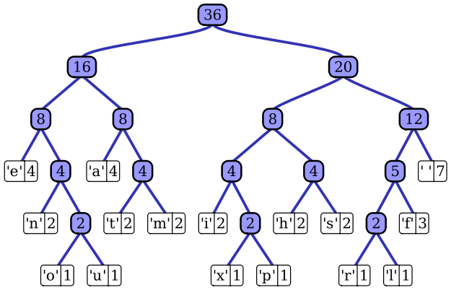
Huffman Coding
Huffman coding is an entropy encoding algorithm used for lossless data compression
Use of a variable-length code table for encoding a source symbol (such as a character in a file) where the variable-length code table has been derived in a particular way based on the estimated probability of occurrence for each possible value of the source symbol
Uses a priority queue based on frequency
Notes:
this is an example of a huffman tree

Slide 5
Huffman Tree – how to build
Compute the frequency of each character in the text (file) you wish to encode
  Allows you to determine which characters should have the fewest bits, etc
Build a “coding tree” from the bottom up according to the frequencies
Suppose we only want to encode the five letters (a, b, c, d, e) and they have frequencies 3, 3, 1, 1, and 2, respectively
  Create a leaf node for each character/frequency pair and put them into a priority queue, so that the characters with lower frequencies appear first:
1
‘c’
1
‘d’
2
‘e’
3
‘a’
3
‘b’

Slide 6
Huffman Tree – how to build
Now we pick the two nodes with the smallest frequencies (the two at the front of the priority queue) and create a new node with those two nodes as children (the first value from the queue becomes the left, the second value from the queue becomes the right). We assign this new branch node a frequency that is the sum of the frequencies of the two children. This new node is then put back into the priority queue:
2
‘e’
2
-
3
‘a’
3
‘b’
1
‘c’
1
‘d’

Slide 7
Huffman Tree – how to build
Continuing in this way, we build up larger and larger subtrees.
3
‘a’
3
‘b’
4
-
2
‘e’
2
-
1
‘c’
1
‘d’
4
-
6
-
2
‘e’
2
-
3
‘a’
3
‘b’
1
‘c’
1
‘d’

Slide 8
Huffman Tree – how to build
And finally
char | freq | code
b | 3 | 11
a | 3 | 10
e | 2 | 00
d | 1 | 011
c | 1 | 010
10
-
4
-
6
-
2
‘e’
2
-
3
‘a’
3
‘b’
1
‘c’
1
‘d’
The Huffman code is derived from this coding tree simply by assigning a zero to each left branch and a one to each right branch. The code can be read directly from the tree. The code for a is 10, the code for b is 11, the code for c is 010, the code for d is 011 and the code for e is 00.

Slide 9
Huffman Tree – how to use
char | freq | code
b | 3 | 11
a | 3 | 10
e | 2 | 00
d | 1 | 011
c | 1 | 010
-
-
-
2
‘e’
-
3
‘a’
3
‘b’
1
‘c’
1
‘d’
Given the following code sequence, figure out the text:
  1011001011011000101110
Traverse the tree until find a leaf – put character in queue
Answer: abeabdecba
Notes:
How is this better?
3x2 + 3x2 + 2x2 + 3 + 3 = 6 + 6 + 4 + 3 + 3 = 22 bits = ~3 bytes
3 vs. 36 bytes
10 + 11 + 00 + 10 + 11 +011 + 00 + 010 + 11 + 10
a + b + e + a + b + d + e + c + a

Slide 10
Activity
Compute the frequency of each character
  Example: for the string “better tree”
  freq_{b}=1, freq_{e}=4, freq_{t}=3, freq_{r}=2, freq_{Space}=1
Build a “coding tree”
  Insert characters into a priority queue, lower-frequency first
    Example: consider each character as a node with char & freq
b | 1
Sp | 1
r | 2
t | 3
e | 4
  Remove first two characters (ie, two with lowest frequency)
  Create a new node, with these two characters as children; new node has a “freq” of the combined frequency of the two children
  Insert new node in priority queue in correct position
    Example:
  Repeat until there is a single tree
r | 2
- | 2
t | 3
e |4
b | 1
Sp| 1

Slide 11
Activity | Huffman Tree
  Repeat until there is a single tree
t | 3
e |4
- |4
r | 2
- | 2
b | 1
Sp| 1
- |4
- |7
r | 2
- | 2
t | 3
e |4
- |11
b | 1
Sp| 1
- |4
- |7
r | 2
- | 2
t | 3
e |4
b | 1
Sp| 1

Slide 12
Activity | Huffman Tree
  Now code each character by its position in the tree:
    Start at the root
    Left branch gets a 0
    Right branch gets a 1
- |11
char | freq | code
e | 4 | 11
t | 2 | 10
r | 1 | 00
Space | 1 | 011
b | 1 | 010
0 1
00 01 10 11
010 011
- |4
- |7
r | 2
- | 2
t | 3
e |4
b | 1
Sp| 1
  Finally build a string: for “beet reet”– 01011111001100111110
  NOTE: each code is unique, i.e., you can decode left-to-right.
  Example: Decode - 01011111001100111110
010
b
11
e
11
e
10
t
011
__
00
r
11
e
11
e
10
t

Slide 13
Huffman Trees – English Alphabet
  A Huffman Tree built from the typical frequency of the letters in the English alphabet looks like this:
-
0 1
00 01 10 11
010 001 010 011 100 101 110 111
0010 0011 0100
0101 0110 0111 1010 1011 1100 1101 1110 1111
00100 00101 00110 00111 01000 01001 11000 11001 11100 11111
001110 001111 110000 110001 111000 111001
0011110 0011111
00111100 00111101
001111000 001111001 001111010 001111011
-
-
-
-
-
-
t
-
-
-
e
-
-
-
-
-
-
r
h
s
n
i
-
o
a
-
f
w
m
-
u
c
-
l
-
d
v
-
b
p
y
g
-
k
-
-
  See next slide for the coding chart
z
q
x
j

Slide 14
Huffman Trees – English Alphabet
  The Huffman coding chart built from the typical frequency of the letters in the English alphabet (https://en.wikipedia.org/wiki/Letter_frequency):
char | freq | code
e | 127 | 100
t | 91 | 010
r | 60 | 0101
h | 61 | 0110
s | 63 | 0111
n | 67 | 1010
i | 70 | 1011
o | 75 | 1101
a | 82 | 1110
f | 22 | 00100
w | 24 | 00101
m | 24 | 00110
u | 28 | 01000
char | freq | code
c | 28 | 01001
l | 40 | 11001
d | 43 | 11111
v | 10 | 001110
b | 15 | 110000
p | 19 | 110001
y | 20 | 111000
g | 20 | 111001
k | 8 | 0011111
z | 1 | 001111000
q | 1 | 001111001
x | 2 | 001111010
j | 2 | 001111011

